Slide 1
FTP

Slide 2
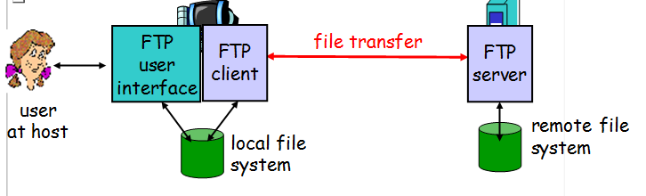
FTP: the file transfer protocol
transfer file to/from remote host
client/server model
client: side that initiates transfer (either to/from remote)
server: remote host
ftp: RFC 959
ftp server: port 21

Slide 3
FTP: separate control, data connections
TCP control connection
port 21
FTP client contacts FTP server at port 21, TCP is transport protocol
client authorized over control connection
client browses remote directory by sending commands over control connection.
when server receives file transfer command, server opens 2nd TCP connection (for file) to client
after transferring one file, server closes data connection.
TCP data connection
port 20
FTP
client
FTP
server
server opens another TCP data connection to transfer another file.
control connection: “out of band”
FTP server maintains “state”: current directory, earlier authentication

Slide 4
FTP commands, responses
Sample commands:
sent as ASCII text over control channel
USER username
PASS password
LIST return list of file in current directory
RETR filename retrieves (gets) file
STOR filename stores (puts) file onto remote host
Sample return codes
status code and phrase (as in HTTP)
331 Username OK, password required
125 data connection already open; transfer starting
425 Can’t open data connection
452 Error writing file

Slide 5
Sample FTP interaction
[01] ftp nic.ddn.mil
[02] connected to nic.ddn.mil
[03] 220 nic FTP server (Sunos 4.1)ready.
[04] Name: anonymous
[05] 331 Guest login ok, send ident as password.
[06] Password: abc@xyz.math.yale.edu
[07] 230 Guest login ok, access restrictions apply.
[08] ftp> cd rfc
[09] 250 CWD command successful.
[10] ftp> get rfc1261.txt nicinfo
[11] 200 PORT command successful.
[12] 150 ASCII data connection for rfc1261.txt
(128.36.12.27,1401) (4318 bytes).
[13] 226 ASCII Transfer complete.
local: nicinfo remote: rfc1261.txt
4488 bytes received in 15 seconds (0.3 Kbytes/s).
[14] ftp> quit
[15] 221 Goodbye.

Slide 6

Summary
What’s the FTP
FTP: separate control, data
FTP commands, responses

